Slide 1
Thank You for turning up. We would like to have your feedback so that we can make the future sessions better. http://goo.gl/tfpO28

Slide 2




Slide 3


Slide 4
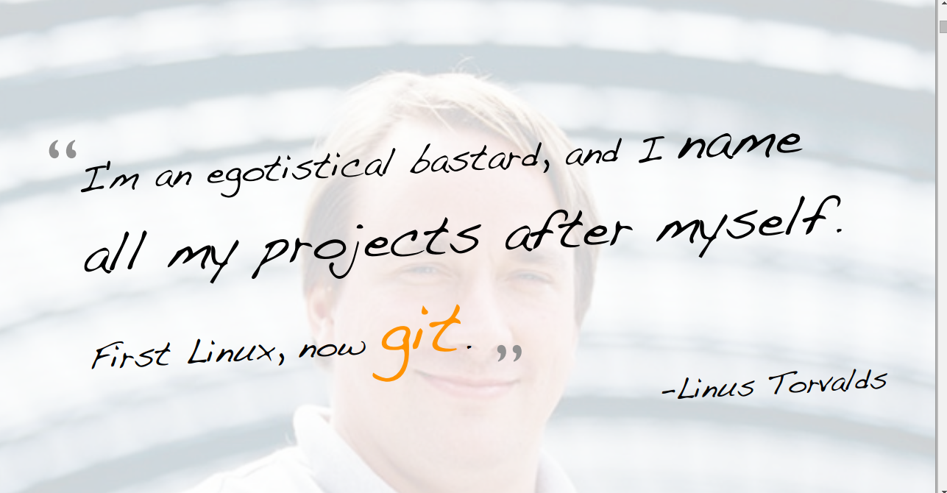

Slide 5
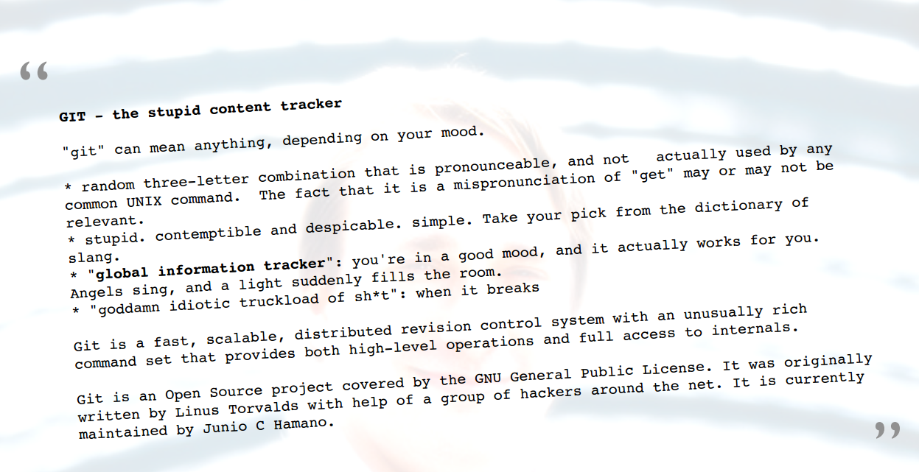

Slide 6






Popular Projects, which took shape under Git

Slide 7
Version control systems
Version control (or revision control, or source control) is all about managing multiple versions of documents, programs, web sites, etc.
Almost all “real” projects use some kind of version control
Essential for team projects, but also very useful for individual projects
Some well-known version control systems are CVS, Subversion, Mercurial, and Git
CVS and Subversion use a “central” repository; users “check out” files, work on them, and “check them in”
Mercurial and Git treat all repositories as equal
Distributed systems like Mercurial and Git are newer and are gradually replacing centralized systems like CVS and Subversion

Slide 8
Why version control?
For working by yourself:
Gives you a “time machine” for going back to earlier versions
Gives you great support for different versions (standalone, web app, etc.) of the same basic project
For working with others:
Greatly simplifies concurrent work, merging changes
For contributing to open source projects:
GSoC! GSoC! GSoC! GSoC!
For getting an internship or job:
Any company with a clue uses some kind of version control
Companies without a clue are bad places to work
Notes:
Cyberoam stuff

Slide 9
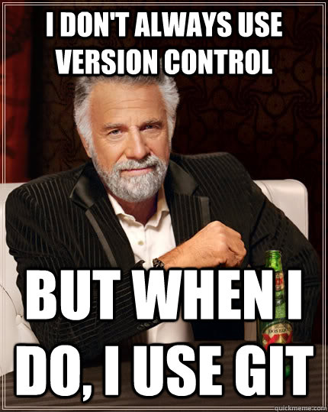
Why Git?
Git has many advantages over earlier systems such as CVS and Subversion
More efficient
Better workflow, etc.
Of course, there are always those who disagree, but git is great. Atleast, Jonathan Goldsmith is on our side.

Slide 10

Design principles
Speed
Simple design
Strong support for non-linear development (thousands of parallel branches) (= Good support for branching and merging)
Fully distributed (Committing code does not require access to a central server)
Able to handle large projects like the Linux kernel efficiently (speed and data size) (13,5 million lines of code)

Slide 11
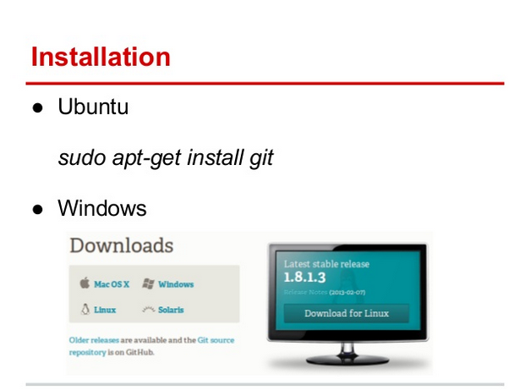

Slide 12
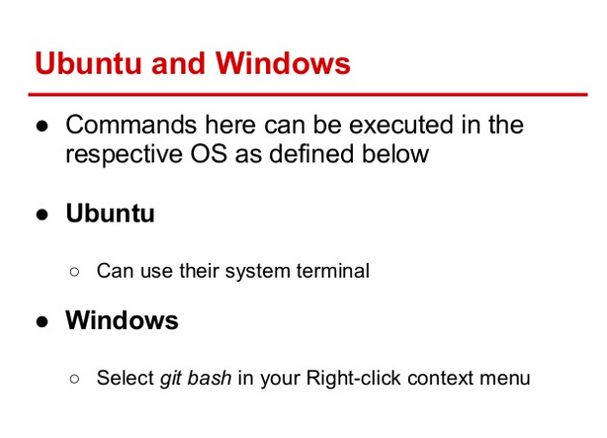

Slide 13
Git terminology
Git Directory
The .git directory that holds all information in the repository
Hidden from view
Working directory
The directory in which .git resides
Contains a "snapshot" of the repository
Will be changed constantly eg. when reverting or branching
Your changes will be made to this directory
Index
Changes have to be added to the index from the working directory in order to be saved.

Slide 14
Git terminology
Branch
An alternate line of development
Working copy
The branch you are in now that you make your changes in
Master
The default branch of the repository

Slide 15
Git object model - Types
Blob
A file
Tree
A directory or subdirectories and files associated with them
Commit
A pointer that marks a single tree to what the project looked at a certain point in time. Contains author, timestamp, a pointer to the previous commit
Tag
A way to mark a certain commit special in some way. Usually used to mark Ready-to-release versions.

Slide 16
Basic operations
Initializing a repository
Basic workflow
Commands:
add
commit
revert
reset
remote
push & pull & fetch

Slide 17
BASIC GIT COMMANDS
Please feel free to stop us anytime that you aren't clear or want us to slow down !

Slide 18
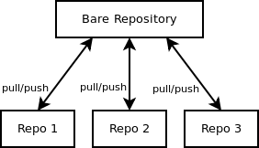
init
Initializes a directory as a git repository.
--bare
--bare gives you just a storage place (you can not develop there).

Slide 19
config
Git provides the git config tool, which allows you to set configuration variables.
To set these configuration values as global, add the -- global option, and if you omit --global option, then your configurations are specific for the current Git repository.

Slide 20
config(contd)
$ git config –list
$ git config --global core.editor vim
$ git config --global user.name “John Doe“
$ git config --global user.email “johndoe@example.com"
$ git config --global color.ui auto

Slide 21
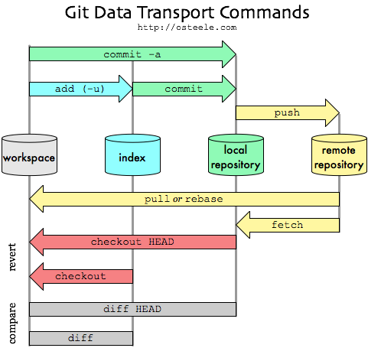

Slide 22
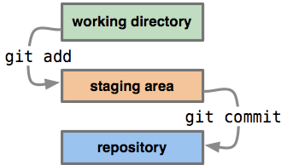
add
It is used to add a file to the staging area.
If the file is already "tracked" - ie, it was in your last commit - you still need to call git add to add new modifications to your staging area.

Slide 23
status
to see what the status of your staging area is compared to the code in your working directory.
Using the -s option will give you short output.

Slide 24
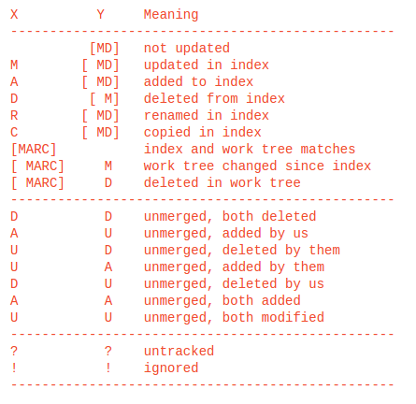

Slide 25
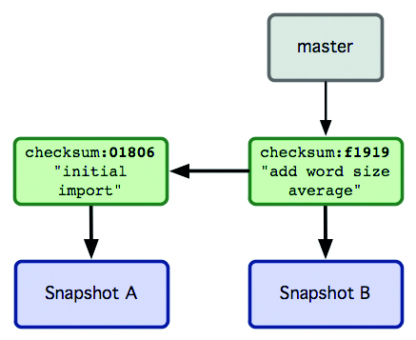
commit
RECORDS A SNAPSHOT OF THE STAGING AREA.

Slide 26
commit(contd)
commit -a: Automatically adds all the unstaged files that have changed to the staging area and then commits.
commit -m: Adds a message to the commit.
Commit –amend: is a convenient way to fix up the most recent commit. It lets you combine staged changes with the previous commit instead of committing it as an entirely new snapshot. It can also be used to simply edit the previous commit message without changing its snapshot.

Slide 27
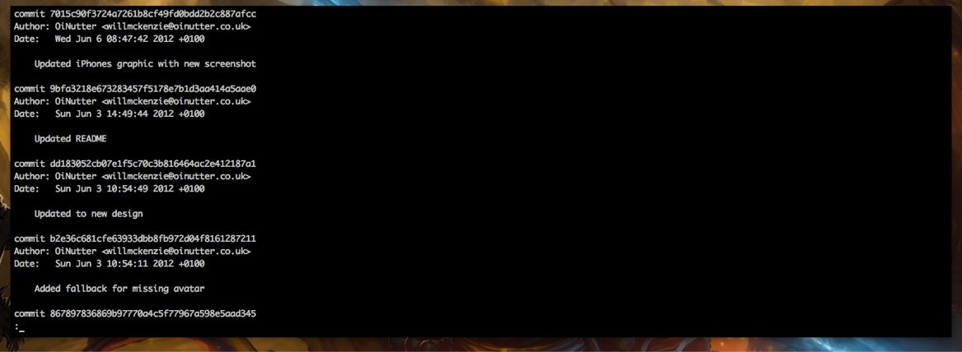
log
Shows the commit logs.
Shows the commit history of a branch.

Slide 28
log(contd)
log –oneline
log --skip=<number>
log --since=<date>
log --after=<date>
log --until=<date>
log --before=<date>
<date=dd/mm/yyyy>

Slide 29
diff
Show changes between the working tree and the index or a tree, changes between the index and a tree, changes between two trees, or changes between two files on disk.
$ diff <file1> <file2>
$ git diff <start commit>..<end commit> -- file
changes that have occured in a file between
two commits.

Slide 30
diff (contd)
$ git diff : Changes in the working tree not yet staged for the next commit.
$ git diff –cached: Changes between the index and your last commit; what you would be committing if you run "git commit" without "-a" option.
$ git diff HEAD: Changes in the working tree since your last commit; what you would be committing if you run "git commit -a"

Slide 31
$ git diff HEAD^ HEAD: Compare the version before the last commit and the last commit.
$ git diff –diff-filter=MRC:Show only modification, rename, and copy, but not addition or deletion.
$ git diff –name-status: Show only names and the nature of change, but not actual diff output.
git diff -R: Shows the output in reverse.

Slide 32
stash
You're in the middle of some changes but something comes up that you need to jump over to, like a so-urgent-right-now bugfix, but don't want to commit or lose your current edits. git stash is there for you.
Stashing takes the current state of the working directory and index, puts it on a stack for later, and gives you back a clean working directory. It will then leave you at the state of the last commit.

Slide 33
Stash(cntd)
git stash
git stash apply
git stash list
git stash drop

Slide 34
GIT checkout(to switch between branches)
The git checkout command serves three distinct functions:
1. checking out files
2. checking out commits
3. checking out branches.
Checking out a commit makes the entire working directory match that commit. This can be used to view an old state of your project without altering your current state in any way.
Checking out a file lets you see an old version of that particular file, leaving the rest of your working directory untouched.

Slide 35
Usage
git checkout master
Return to the master branch.
git checkout <commit>
Update all files in the working directory to match the specified commit. You can use either a commit hash or a tag as the <commit> argument. This will put you in a detached HEAD state.

Slide 36
git-rm
- Remove files from the working tree and from the index
- Thus, given two directories d and d2, there is a difference between using git rm 'd*' and git rm 'd/*', as the former will also remove all of directory d2.

Slide 37
GIT revert
The git revert command undoes a committed snapshot. But, instead of removing the commit from the project history, it figures out how to undo the changes introduced by the commit and appends a new commit with the resulting content. This prevents Git from losing history, which is important for the integrity of your revision history and for reliable collaboration.

Slide 38
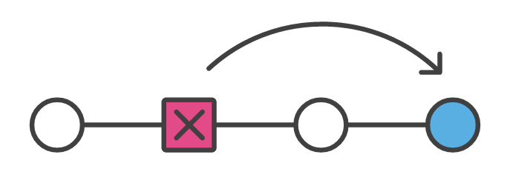

Slide 39
GIT reset
Three types of reset
--soft
--mixed(default)
--hard

Slide 40
git reset <file>
Remove the specified file from the staging area, but leave the working directory unchanged. This unstages a file without overwriting any changes.

Slide 41
Default reset (--mixed)
git reset
Reset the staging area to match the most recent commit, but leave the working directory unchanged. This unstages all files without overwriting any changes, giving you the opportunity to re-build the staged snapshot from scratch.

Slide 42
--hard reset
git reset --hard
Reset the staging area and the working directory to match the most recent commit. In addition to unstaging changes, the --hard flag tells Git to overwrite all changes in the working directory, too. Put another way: this obliterates all uncommitted changes, so make sure you really want to throw away your local developments before using it.

Slide 43
--soft reset
The --soft parameter tells Git to reset HEAD to another commit, but that’s it. If you specify --soft Git will stop there and nothing else will change. What this means is that the index and working copy don’t get touched, so all of the files that changed between the original HEAD and the commit you reset to appear to be staged.

Slide 44

Towards Collaboration over the internet

Slide 45
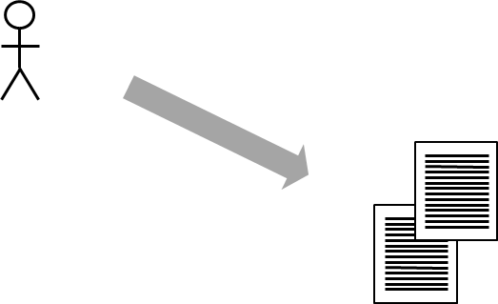
Shaleen

Slide 46
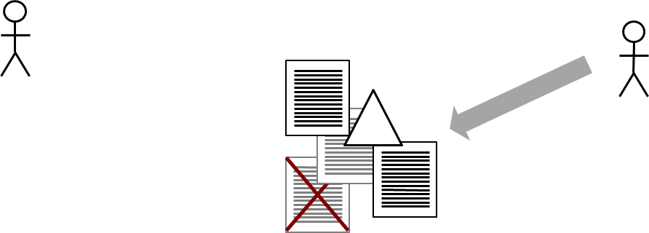
Shaleen
Yashwant

Slide 47
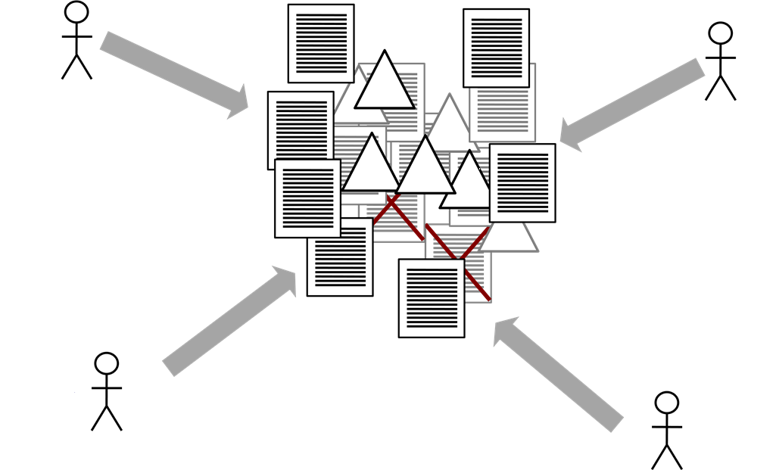
Shaleen
Yashwant
Nidhi
Ankit
A recipe for disaster!

Slide 48
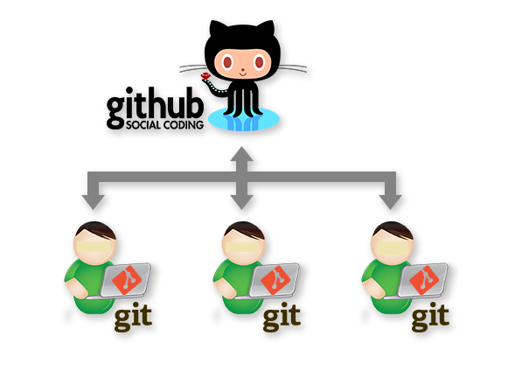


Slide 49
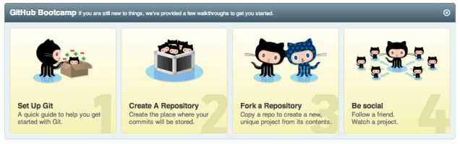
Step One: Sign Up for GitHub

Slide 50
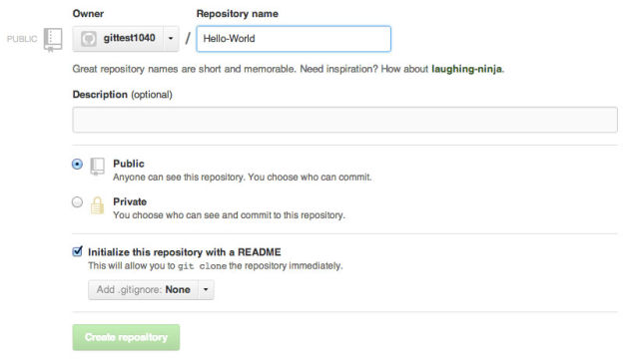
Step Two: Create Your First Repository

Slide 51
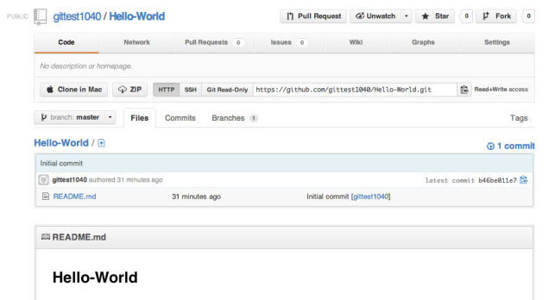
Step Three: Make Your First Commit

Slide 52
branch
Branch operation allows creating another line of development. We can use this operation to fork off the development process into two different directions. For example, we released a product for 6.0 version and we might want to create a branch so that the development of 7.0 features can be kept separate from 6.0 bug fixes

Slide 53
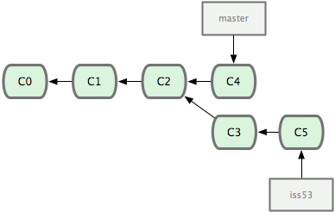

Slide 54
git branch -v see the last commit on each branch
$ git branch -v
*master 54b417d fix javascript issue
development 74c111d modify component.json file
testing 62a557a update test scripts
Git branch -d <branchname>: Deletes the branch branchname
Git branch -D <branchname> Deletes the branch branchname irrespective of the merge status.

Slide 55
git-remote
Manage set of tracked repositories
The git remote command lets you create, view, and delete connections to other repositories. Remote connections are more like bookmarks rather than direct links into other repositories. Instead of providing real-time access to another repository, they serve as convenient names that can be used to reference a not-so-convenient URL.
For example, the following diagram shows two remote connections from your repo into the central repo and another developer’s repo. Instead of referencing them by their full URLs, you can pass the origin and john shortcuts to other Git commands.

Slide 56
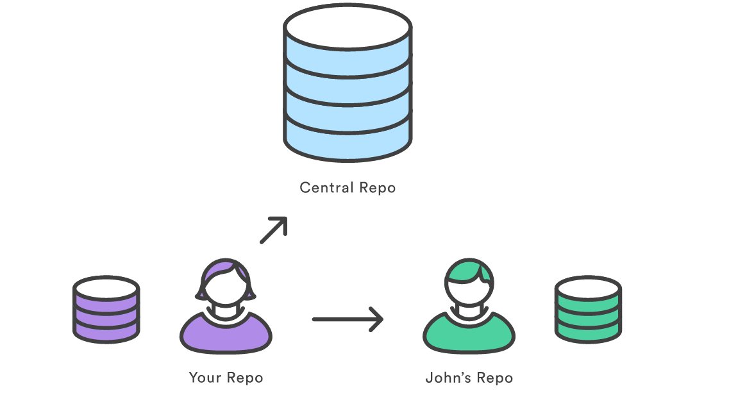

Slide 57
git remote
List the remote connections you have to other repositories.
git remote -v
Same as the above command, but include the URL of each connection.
git remote add <name> <url>
Create a new connection to a remote repository. After adding a remote, you’ll be able to use <name> as a convenient shortcut for <url> in other Git commands.

Slide 58
git remote rm <name>
Remove the connection to the remote repository called <name>.
git remote rename <old-name> <new-name>
Rename a remote connection from <old-name> to <new-name>.

Slide 59
Why remotes?
Git is designed to give each developer an entirely isolated development environment. This means that information is not automatically passed back and forth between repositories. Instead, developers need to manually pull upstream commits into their local repository or manually push their local commits back up to the central repository. The git remote command is really just an easier way to pass URLs to these “sharing” commands.

Slide 60
Remote Branches
Remote branches are just like local branches, except they represent commits from somebody else’s repository. You can check out a remote branch just like a local one, but this puts you in a detached HEAD state (just like checking out an old commit). You can think of them as read-only branches.
you can inspect these branches with the usual git checkout and git log commands. If you approve the changes a remote branch contains, you can merge it into a local branch with a normal git merge.

Slide 61
git fetch
The git fetch command imports commits from a remote repository into your local repo. The resulting commits are stored as remote branches instead of the normal local branches that we’ve been working with. This gives you a chance to review changes before integrating them into your copy of the project.

Slide 62
git fetch <remote>
Fetch all of the branches from the repository. This also downloads all of the required commits and files from the other repository.
git fetch <remote> <branch>
Same as the above command, but only fetch the specified branch.

Slide 63
Why do we do it?
Fetching is what you do when you want to see what everybody else has been working on. Since fetched content is represented as a remote branch, it has absolutely no effect on your local development work. This makes fetching a safe way to review commits before integrating them with your local repository. It’s similar to svn update in that it lets you see how the central history has progressed, but it doesn’t force you to actually merge the changes into your repository.

Slide 64
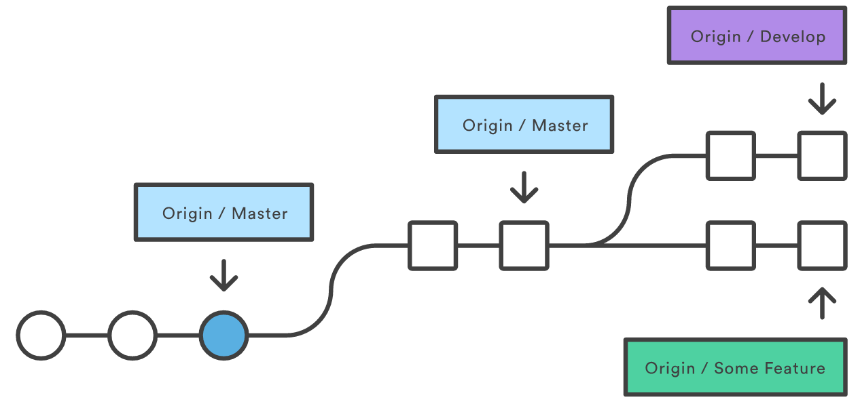
The commits from these new remote branches are shown as squares instead of circles in the diagram below. As you can see, git fetch gives you access to the entire branch structure of another repository.

Slide 65
git pull
Merging upstream changes into your local repository is a common task in Git-based collaboration workflows. We already know how to do this with git fetch followed by git merge, but git pull rolls this into a single command.
So, pull is basically git fetch followed by a git merge.

Slide 66
One can inspect these(remote) branches with the usual git checkout and git log commands. If you approve the changes a remote branch contains, you can merge it into a local branch with a normal git merge.

Slide 67
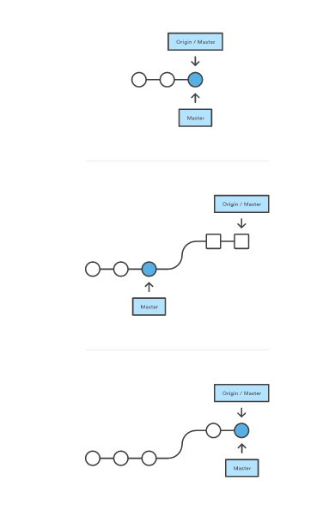

Slide 68
git pull <remote>
Fetch the specified remote’s copy of the current branch and immediately merge it into the local copy. This is the same as git fetch <remote> followed by git merge origin/<current-branch>.

Slide 69
merge
Once you have work isolated in a branch, you will eventually want to incorporate it into your main branch. You can merge any branch into your current branch with the git merge command.
The Git merge command tries to put the commits from other branches on top of the HEAD of the current local branch. For example, your local branch has commits A−>B−>C−>D and the merge branch has commits A−>B−>X−>Y, then git merge will convert the current local branch to something like A−>B−>C−>D−>X−>Y.

Slide 70


Slide 71
MERGE CONFLICT
In situations where the same block of code is edited in different branches there is no way for a computer to figure it out, so it's up to us.
--commit: Perform the merge and commit the result.
--no-commit: With --no-commit perform the merge but pretend the merge failed and do not autocommit, to give the user a chance to inspect and further tweak the merge result before committing.
--ff: When the merge resolves as a fast-forward, only update the branch pointer, without creating a merge commit. This is the default behavior.

Slide 72
git branch -v see the last commit on each branch
$ git branch -v
*master 54b417d fix javascript issue
development 74c111d modify component.json file
testing 62a557a update test scripts
Git branch -d <branchname>: Deletes the branch branchname
Git branch -D <branchname> Deletes the branch branchname irrespective of the merge status.

Slide 73
git rebase
Rebasing is the process of moving a branch to a new base commit. The general process can be visualized as the following:

Slide 74
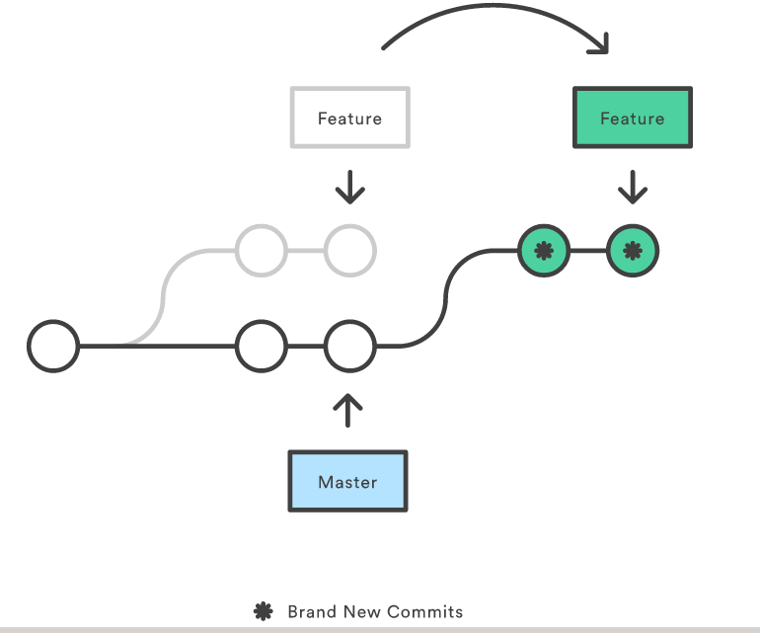

Slide 75
From a content perspective, rebasing really is just moving a branch from one commit to another. But internally, Git accomplishes this by creating new commits and applying them to the specified base—it’s literally rewriting your project history. It’s very important to understand that, even though the branch looks the same, it’s composed of entirely new commits.

Slide 76
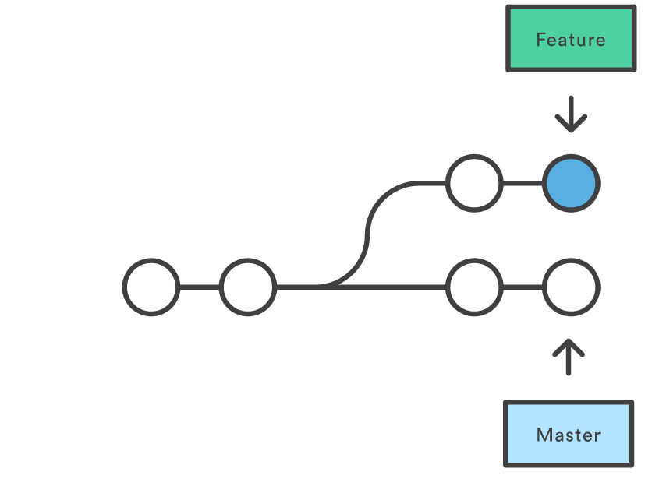
Why do we do it?
The primary reason for rebasing is to maintain a linear project history. For example, consider a situation where the master branch has progressed since you started working on a feature:

Slide 77
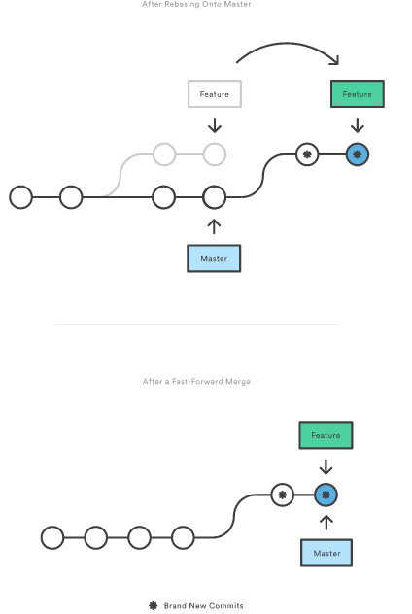

Slide 78
NOTE
Don’t Rebase Public History
As we’ve discussed with git commit --amend and git reset, you should never rebase commits that have been pushed to a public repository. The rebase would replace the old commits with new ones, and it would look like that part of your project history abruptly vanished.

Slide 79
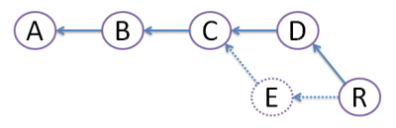
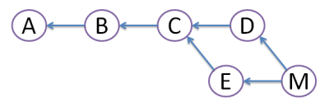
git diff rebase merge

Slide 80
git push
Pushing is how you transfer commits from your local repository to a remote repo. It's the counterpart to git fetch, but whereas fetching imports commits to local branches, pushing exports commits to remote branches. This has the potential to overwrite changes, so you need to be careful how you use it.

Slide 81
Usage
git push <remote> <branch>
Push the specified branch to <remote>, along with all of the necessary commits and internal objects. This creates a local branch in the destination repository. To prevent you from overwriting commits, Git won’t let you push when it results in a non-fast-forward merge in the destination repository.
git push <remote> --force
Same as the above command, but force the push even if it results in a non-fast-forward merge. Do not use the --force flag unless you’re absolutely sure you know what you’re doing.

Slide 82
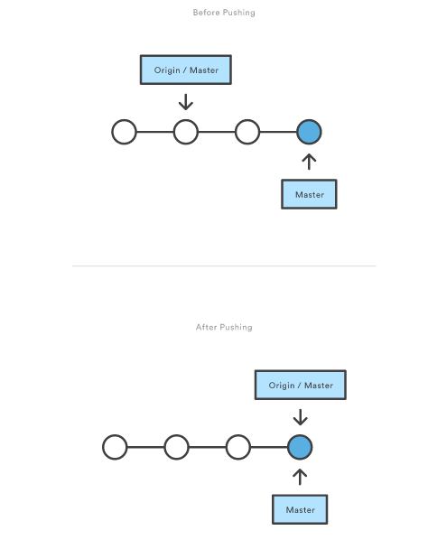

Slide 83
tags
Git has the option to tag a commit in the repository history so that you find it easier at a later point in time. Most commonly, this is used to tag a certain version which has been released.

Slide 84
Git supports two different types of tags, lightweight and annotated tags.
A lightweight tag is a pointer to a commit, without any additional information about the tag.
An annotated tag contains additional information about the tag, e.g., the name and email of the person who created the tag, a tagging message and the date of the tagging. Annotated tags can also be signed and verified with GNU Privacy Guard (GPG).

Slide 85
Using tags
You can list the available tags via the following command:
git tag
You can use the -l parameter in the git tag command to search for a pattern in the tag.
git tag -l <pattern>
To create a lightweight tag don't use the -m, -a or -s option.The following command tags the current active HEAD.
git tag 1.3.37

Slide 86
You can create a new annotated tag via the git tag -a command. An annotated tag can also be created using the -m parameter, which is used to specify the description of the tag. The following command tags the current active HEAD.
# create tag
git tag 1.3.37 -m 'Ballmer peak'
# show the tag
git show 1.3.37

Slide 87
You can also create tags for a certain commit id.
git tag 1.5.1 -m 'version 1.5' [commit id]

